Slide 1


Customer Churn Analysis
By Christina Vosnak

Slide 2
Business Problem
The loss of clients/subscribers is a critical issue for any business
Necessary to build and maintain customer loyalty to drive financial results and build a positive reputation
Notes:
Customer churn, or the loss of clients or subscribers, is a critical issue within any industry and business. To maintain profitability, it is necessary, especially in competitive markets, to build and maintain customer loyalty not only to drive financial results but also to build a positive reputation in the market. This project specifically looks at customer churn data from a telecommunication company to develop predictive models to uncover patterns and factors contributing to customer attrition that can be standardized across industries.

Slide 3
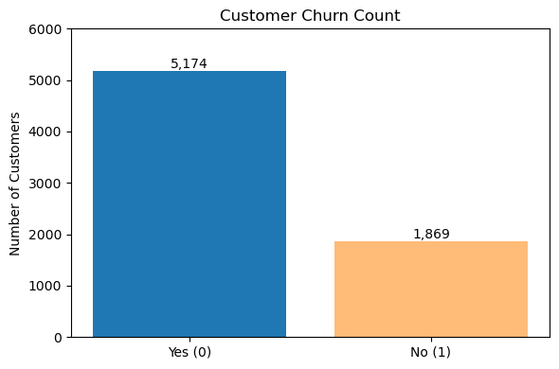
Data Collection
IBM Dataset from a Telecom Company
Over 7000 entries across 21 features
Slightly imbalanced
Exploratory Data Analysis
No missing values or duplicates
Highly categorical > created dummy variables
Notes:
This project takes a look at a data set sourced from Kaggle that was provided by IBM regarding a Telecom Company. It contains over 7000 entries across 21 features with the target variable being whether or not a customer churned. From the chart provided, we can see that the data is slightly imbalaned which may affect results. After conducting an exploratory data analysis, I found that there were no missing or duplicate values however, I noticied the information was mostly categorical so I created dummy variables to prepare the dataset for model building.

Slide 4
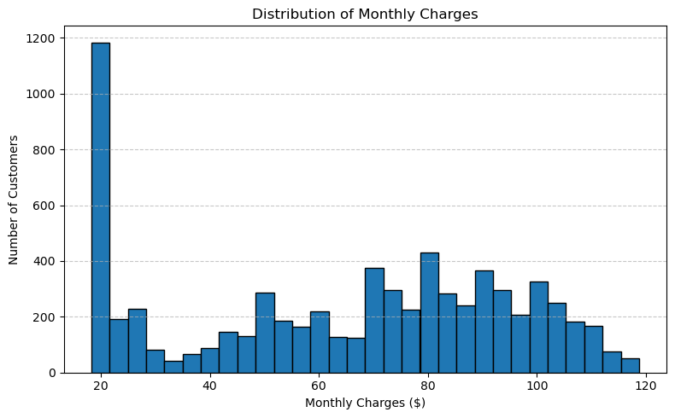
Distribution of Monthly Charges
Notes:
One of the only numerical columns in the dataset is the distribution of monthly charges. Because of this, I created a distribution chart to see if high transaction costs may contribute to customer churn and found that most transactions are at a rate of $20 however, some transactions can range up to $120.

Slide 5
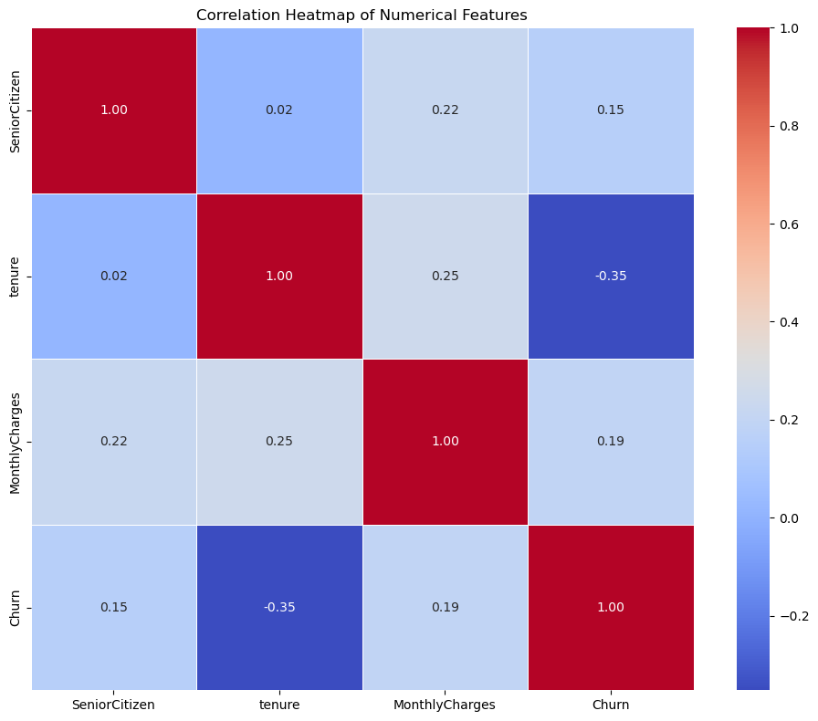
Correlation Heatmap
Notes:
Once again, there are very few numerical columns however I still created a correlation heatmap to see if any trends existed in the data and nothing is of real significance at this point.

Slide 6
Methods
SMOTE – For handling data imbalance
Logistic Regression
Random Forest Classifier
XGBoost
Notes:
I will first be using smote to balance the dataset. From there I will build 3 predictive models: LR RFC & XBG to train and test he data to understand relationships and factors that may cause customers to churn from this company. I chose a logistic regression as a baseline due to its simplicity and interpretability, a random forest classifiey as a powerful model to handle imbalanced data and feature importance insights, and XGBoost which is a high-performance gradient boosting algorithm know for its accuracy and ability to handle complex relationships with data

Slide 7
Evaluation Metrics
Precision
Recall
F1-Score
AUC-ROC
Notes:
I also selected four evaluation metrics to assess the performance of each model and identify the best fit for predicting customer churn. Precision was used to measure how many of the customers predicted to churn actually did, helping to evaluate the accuracy of positive predictions. Recall was chosen to show how many actual churners were correctly identified by the model, which is critical in minimizing lost customers. The F1-score provides a balance between precision and recall, offering a more comprehensive measure of the model’s effectiveness. Lastly, the AUC-ROC score was used to evaluate how well the model distinguishes between churners and non-churners across various classification thresholds.

Slide 8
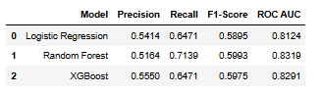
Results
Notes:
We can see the performance of the three models—Logistic Regression, Random Forest, and XGBoost—summarized in the chart on this slide. Logistic Regression and XGBoost both achieved the highest recall (0.8471), meaning they were the most effective at identifying actual churners. However, XGBoost had the highest precision (0.5550), resulting in a more balanced F1-Score of 0.5975. Random Forest, while slightly lower in recall, produced the highest F1-Score overall (0.5993) and the top ROC AUC score (0.8319), making it the most effective model in terms of overall predictive power. These results suggest that both Random Forest and XGBoost offer a better balance of accuracy and reliability compared to Logistic Regression, which still performed strongly in recall.

Slide 9
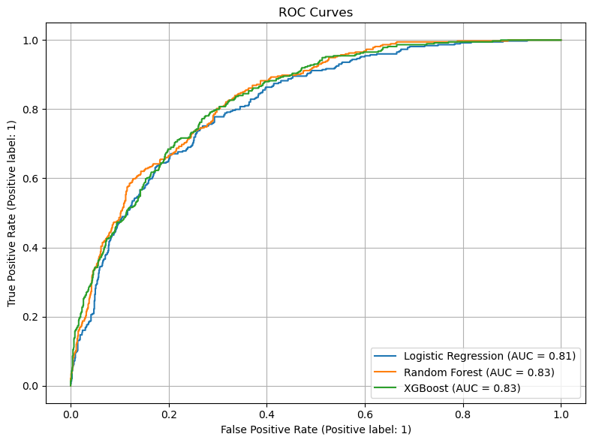
ROC Curves
Notes:
However, when looking at ROC Curves, we see that all models performed about the same

Slide 10
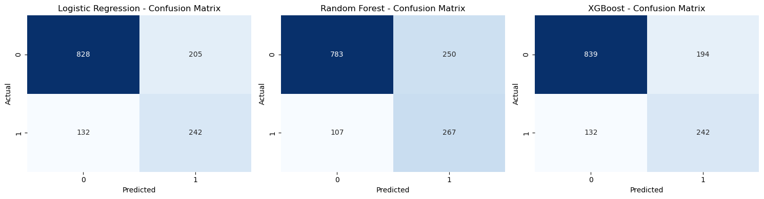
Confusion Matrices
Notes:
Finally, I created a confusion matrix for each model to visually assess how well each one predicted customer churn. Logistic Regression correctly identified 242 churners (true positives) but also misclassified 205 non-churners as churners (false positives), leading to a notable number of incorrect churn predictions. Random Forest had the highest number of true positives at 267 and reduced false positives to 250, striking the best overall balance between sensitivity and specificity. XGBoost achieved the same number of true positives as Logistic Regression (242) but had the lowest number of false positives among the three models at 194, suggesting stronger precision. These results highlight that while all models were reasonably effective in detecting churn, Random Forest offered the best recall, while XGBoost provided a slightly more conservative but precise prediction approach.

Slide 11
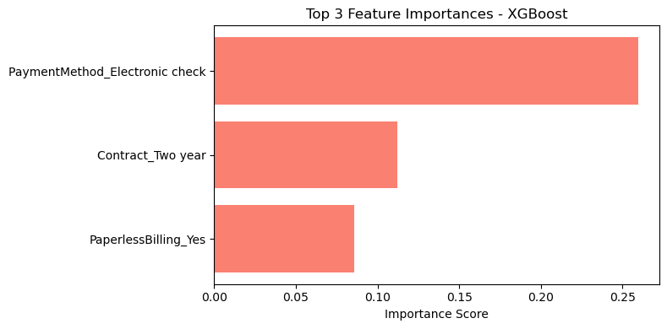
Top 3 Features
Notes:
From the XGBoost model, I found the top 3 features contributing to customer churn. Most significantly was payment method by electronic check followed by customers with a two-year contract and then customers enrolled in paperless billing. However, it is important to note that none of these features are highly significant due to their low importance scores.

Slide 12
Conclusion
No model yielded significant results
XGBoost performed best
Additional classifier models should be tested

Slide 13
Next Steps
Include sentiment and behavioral data
Look at data over longer periods of time
Segment the data to specific regions rather than overall information
Use big data architecture to predict real time customer churn
Notes:
Finally, some recommendations that I can make upon this analysis beyond building additional models is to also look at sentiment and behavioral data to analyze features such as customer satisfaction and support tickets. Additionally, Model builders should segment the data in a way that is accurate for specific regions but captures churn rationale over longer periods of time as churn reasoning consistently is changing, consistent testing of model accuracy is necessary to deliver the most accurate results to companies on churn predictions. Finally, the data used in this analysis is only a small parentage of the available information. Once an ideal model is selected, I would recommend running the model within a big data architecture such as Hive and Spark to analyze real time data instantaneously to prevent customer churn by addressing customer concerns immediately before the thought of churn is possible.

Slide 14

Thank you

